Slide 1
Adult Depression
Hunter Katigbak

Slide 2
Agenda
What are patterns in Adult depression based on each individual's circumstance or attributes.
Create visualizations to better understand how each category fluctuate throughout time
What are possible reasonings for why each category either increase or decrease
What comparisons can we make between categories and why they could relate to each other
What are the discrepancies between each factor and why they exist

Slide 3
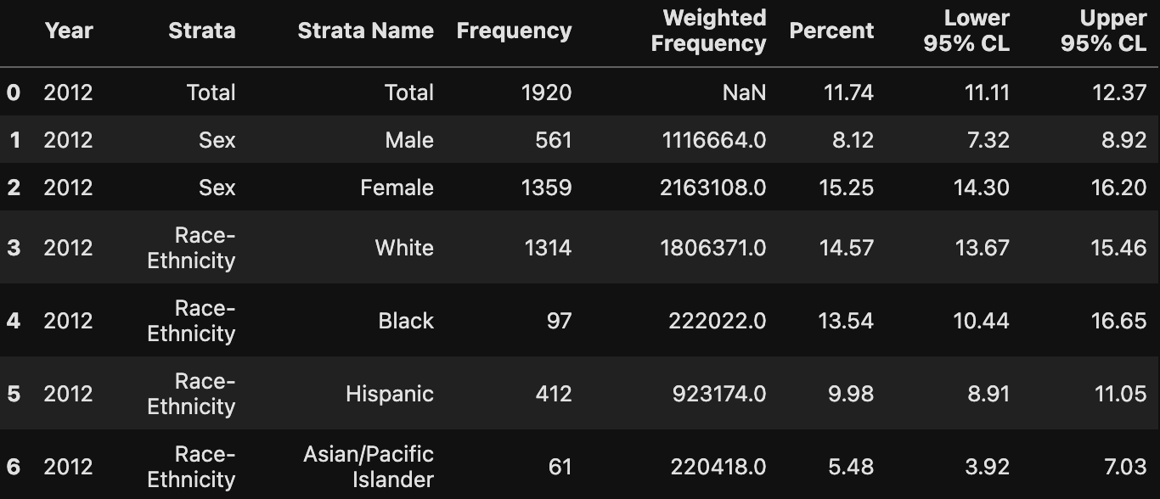
Dataset
Dataset was gathered from Data.Gov
Data from adults starting in 2012 to 2018
Data was gathered from surveys
Categories include Ethnicity, Education, Income, Age, Sex
Other information include percentile, individuals with depression and population, and percentages based on population

Slide 4
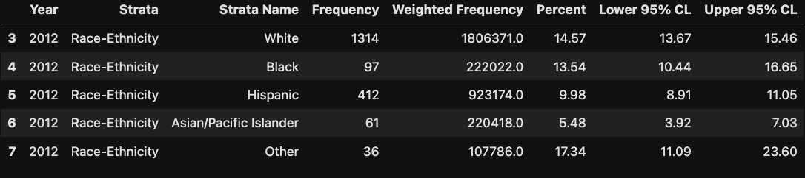
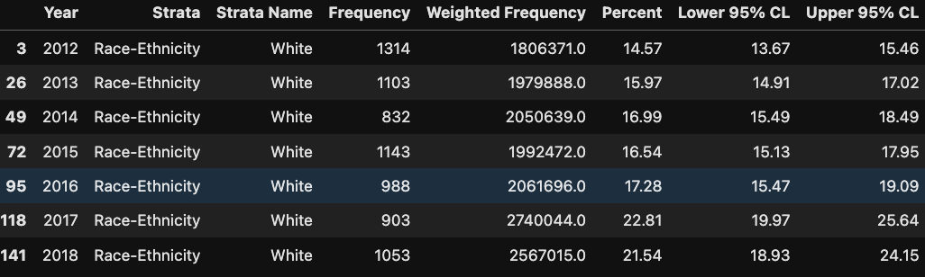
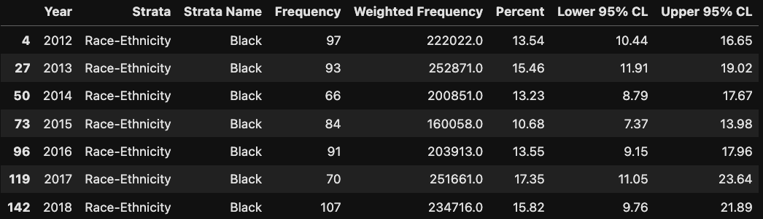
Data Cleaning
Created dataframes based on each category
Ignored other as they are combination of other factors and was not specified
From each category, each attribute were separated by year to better track changes in trends in time
Each category has sub-categories

Slide 5
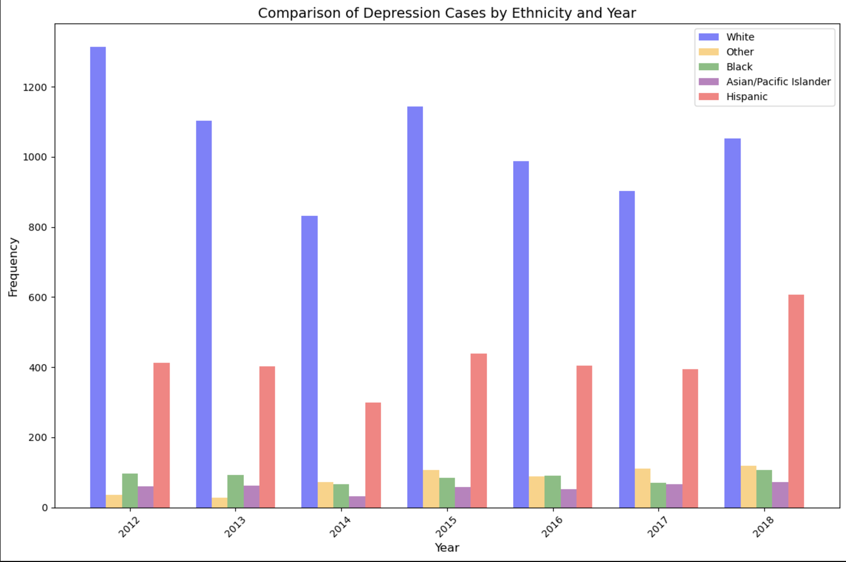
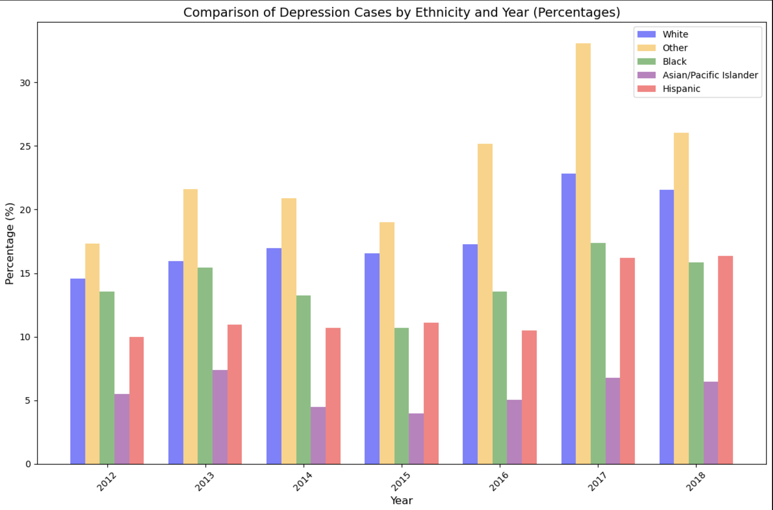
Population vs Percentage
Originally, the data was primarily based on population rather than percentage. This caused an error as certain groups were underrepresented due to population difference. Switching over to percentage rather than population output better representation in each category.

Slide 6
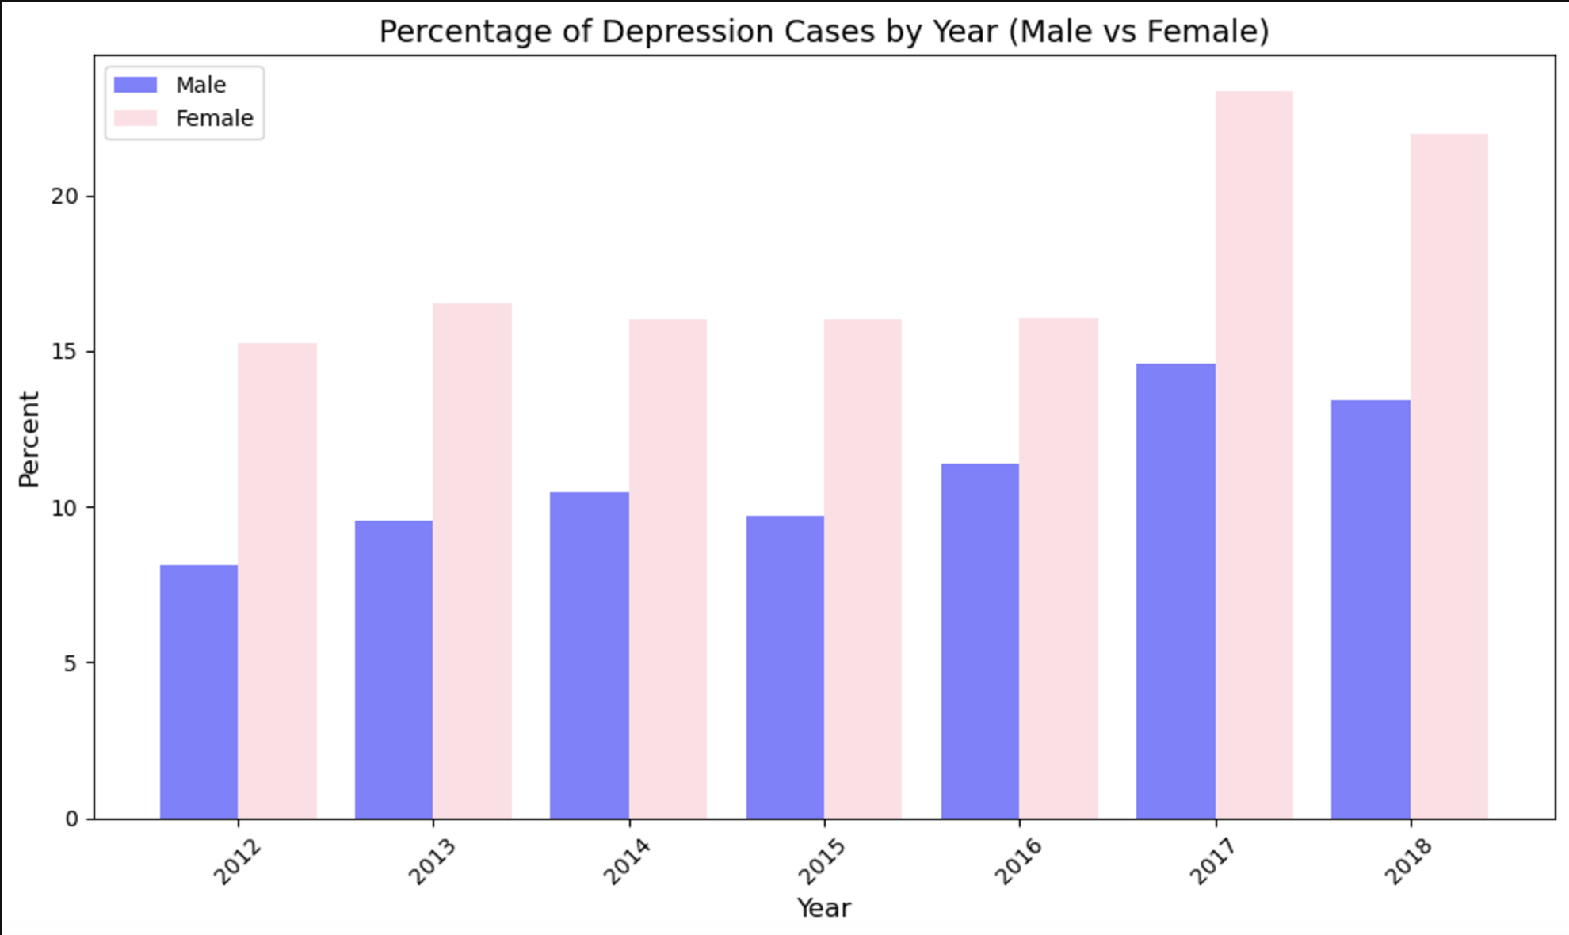
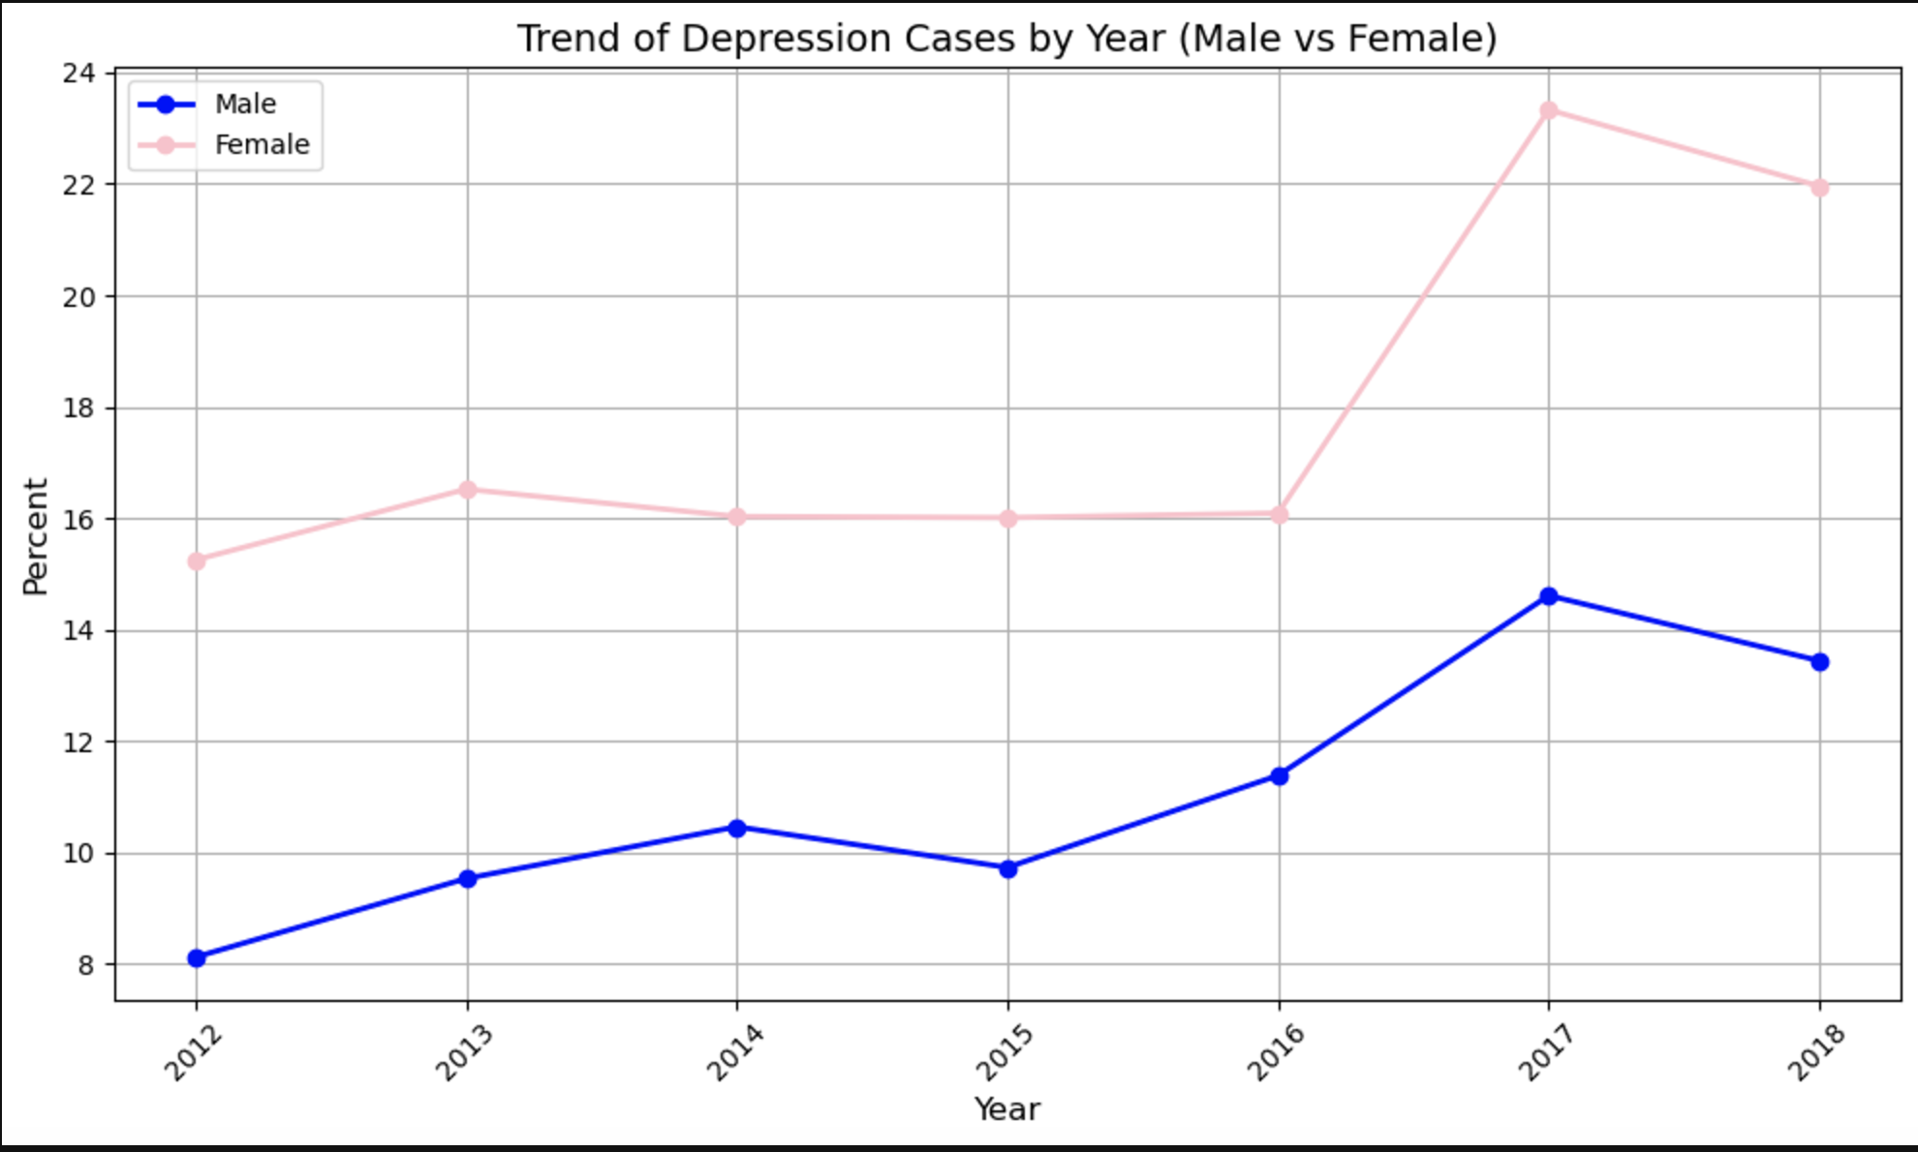
Male vs Female
Separated male vs female data
Females are more prone to depression by a considerable margin
Men are more likely to commit suicide
One consideration could be that women are better at handling depression compared to men

Slide 7
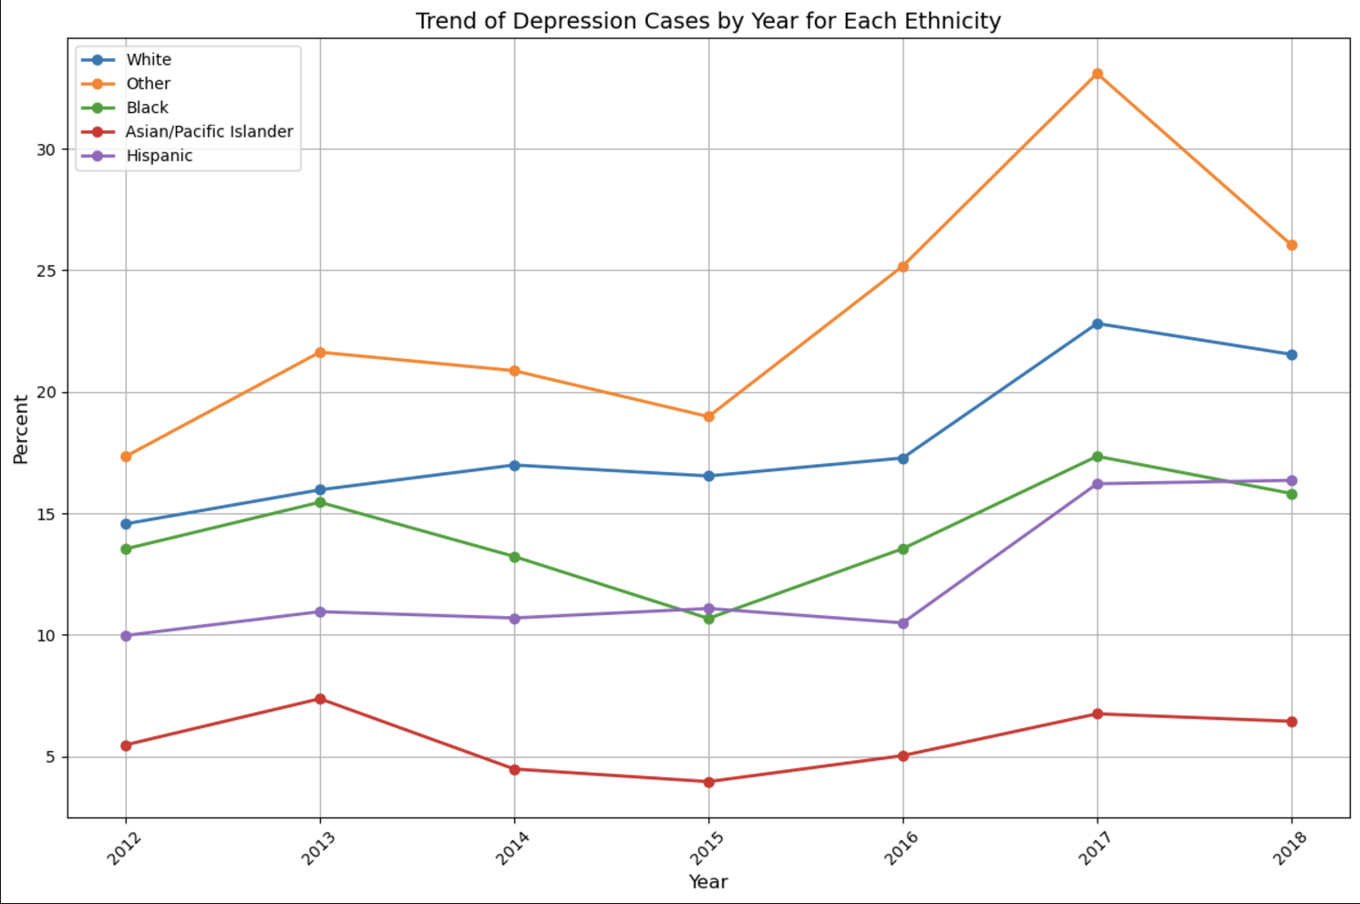
Ethnicity
The highest depression levels are by individuals categorized by other
Asians are less likely to be depressed
This could be related to communities as it is harder to find communities the lower the population

Slide 8
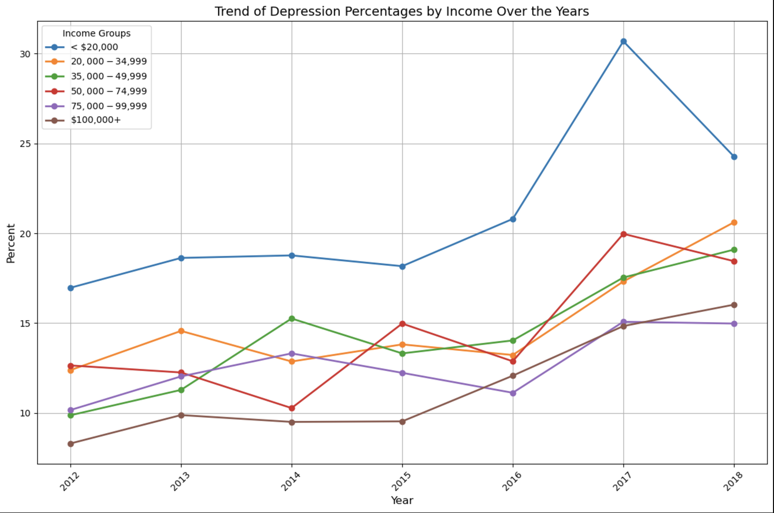
Income
Individuals making under $20,000 are more depressed by a considerable margin
Lowest depression percentage is individuals making $100,000 and above
Money is a big factor in depression rates similar to women

Slide 9
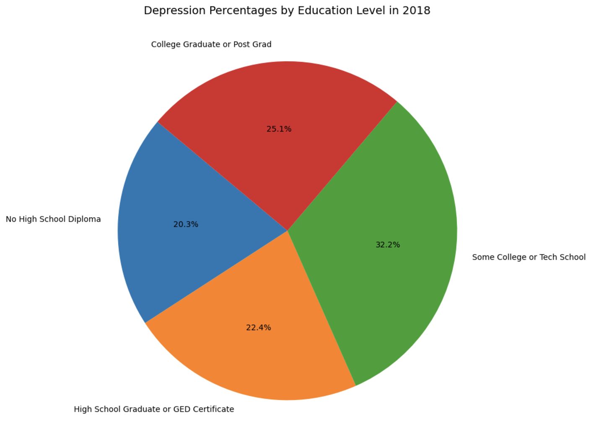
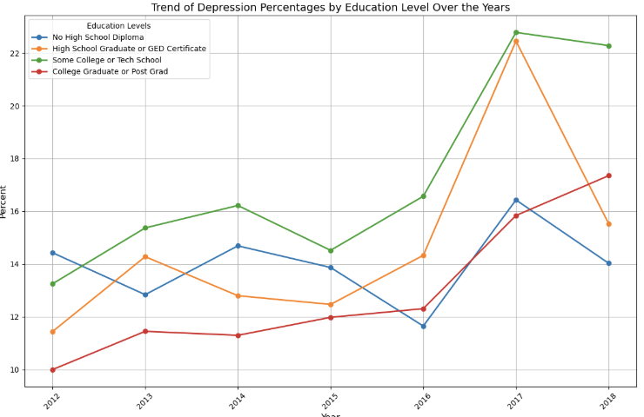
Education
There as a high jump in depression rate for individuals with a Highschool diploma or GED
For 2018, Individuals with a college education rank higher than those without
Education does not determine income levels

Slide 10
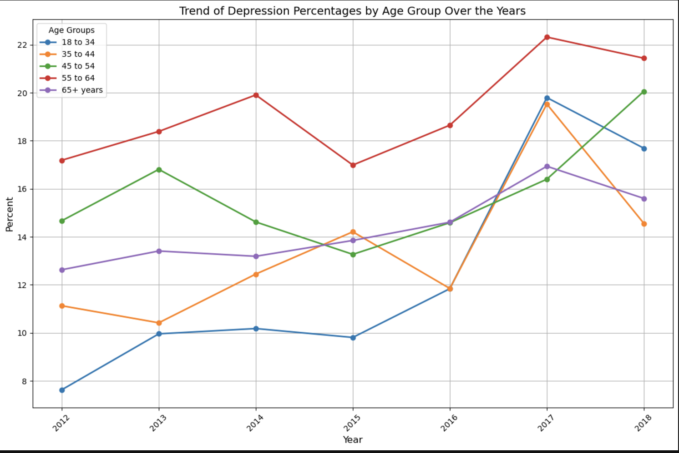
Age
Highest depression rates are from ages 55 to 64
Ages 18 to 34 went from lowest to second highest in one year
Ages 35 to 44 has the highest fluctuation within the age group
While 65+ has the least fluctuation over time

Slide 11
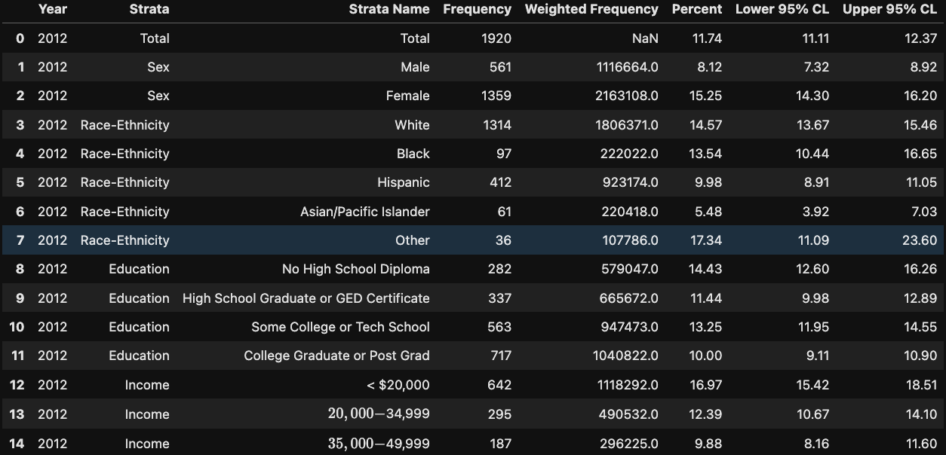
Limitations
Dataset was survey based. They are self-reported data.
There are multiple factors in depression. Other life factors such as family, financial situation, social activity, location, weather, etc.
One of the categories for attributes include “Total”. Which means they fit in more than one category.
Access to mental health resources. Not everyone has access to therapy or professional help as they usually come with cost or time investments.
There are some missing data within the dataset itself
The data spans from 2012 to 2018

Slide 12
Takeaways
The biggest factor in depression rate is money, those with lower income has recorded the highest percentage of depression. For Individuals making under 20k, depression rate increased by 10% in 2016 to 2017.
Ages 18 to 34 recorded lowest depression rate but jumped to the second, this could be due to stressful changes, such as careers or education.
Women are more prone to depression even though men have a higher suicide rate.
Individuals with others as their ethnicity rank higher in depression, this could be because of less access to their own communities. Along with other factors such as socioeconomic status, this could explain why Asians/ Pacific Islander groups have lower depression rates due to higher income than others.
In every single category, 2016 recorded an increase in depression percentages. This could be due to inflation as money is a significant factor in depression rates. This could also be due to increase in social media usage. Which could also explain why 18 to 34 recorded the highest jump in depression as they are more prone to social media.

Slide 13
The End

